Slide 1
Jabil PowerPoint Template
This template should be used for all Jabil presentations.
See additional resources at the end of this deck.

Slide 2
What is Generative AI ?

Slide 3
How to choose the best model

Slide 4
What is Token
https://learn.microsoft.com/en-us/dotnet/ai/conceptual/understanding-tokens

Slide 5
Improve Accuracy of LLM

Slide 6
The following slides will help you
Build a Great Deck.
Do not include these instructional slides in your final presentation.

Slide 7
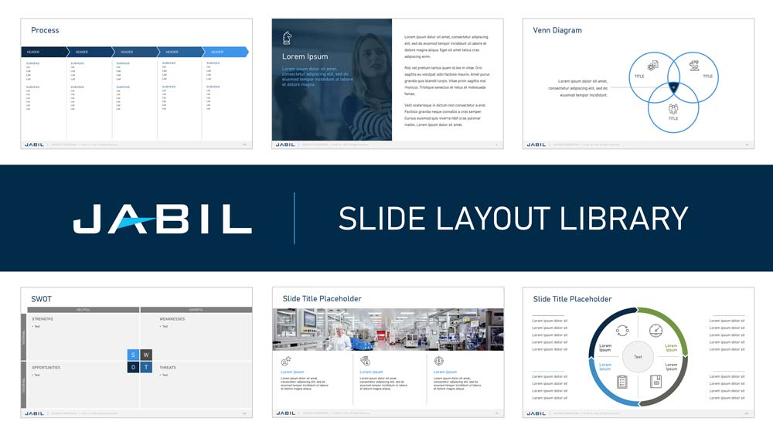







Resources
To use the links below, view this slide in Reading View or Presentation Mode.
Brand Portal | Find more resources and pull content from existing slides.
Cover Images
Images for all industries — pre-cropped to work perfectly on your cover.
Section Header Images
Images for all industries — pre-cropped for section header slides.
Slide Layout Library
We currently have over 200 layouts to help jumpstart your presentations.
Icon Library
We have over 1,300 icons.
Healthcare Illustration Library
Check back from time-to-time. We are always adding new content, images, layouts, and icons.

Slide 8
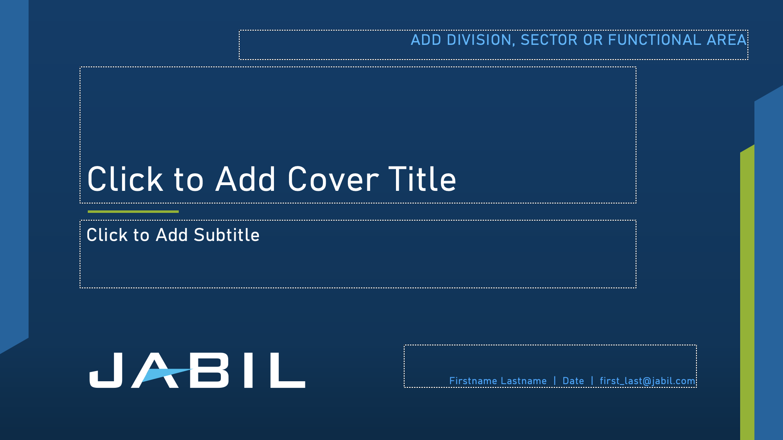




Cover/Title Slides
5 options are built into this template.
No image required
Built-in imagery
Add your own image
Pre-cropped images for all industries are available in the
Cover Image Library.

Slide 9



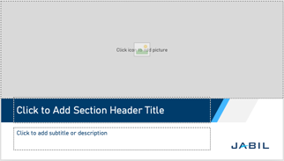
Section Header/Divider Slides
4 options are built into this template.
No image required
Built-in imagery
Add your own image
Pre-cropped images for all industries are available in the
Section Header Image.

Slide 10



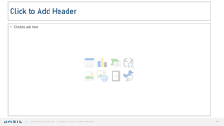
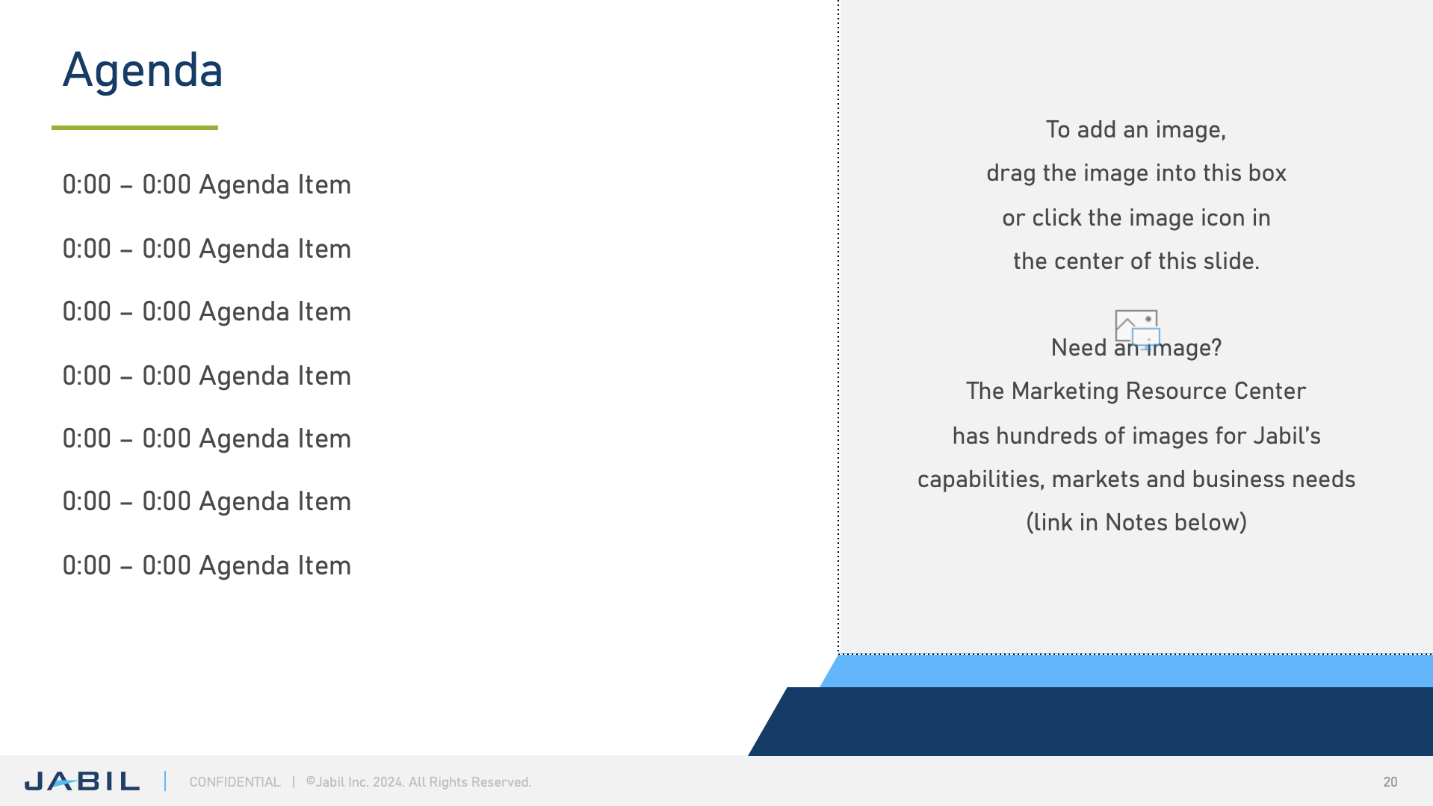

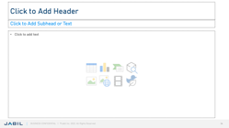
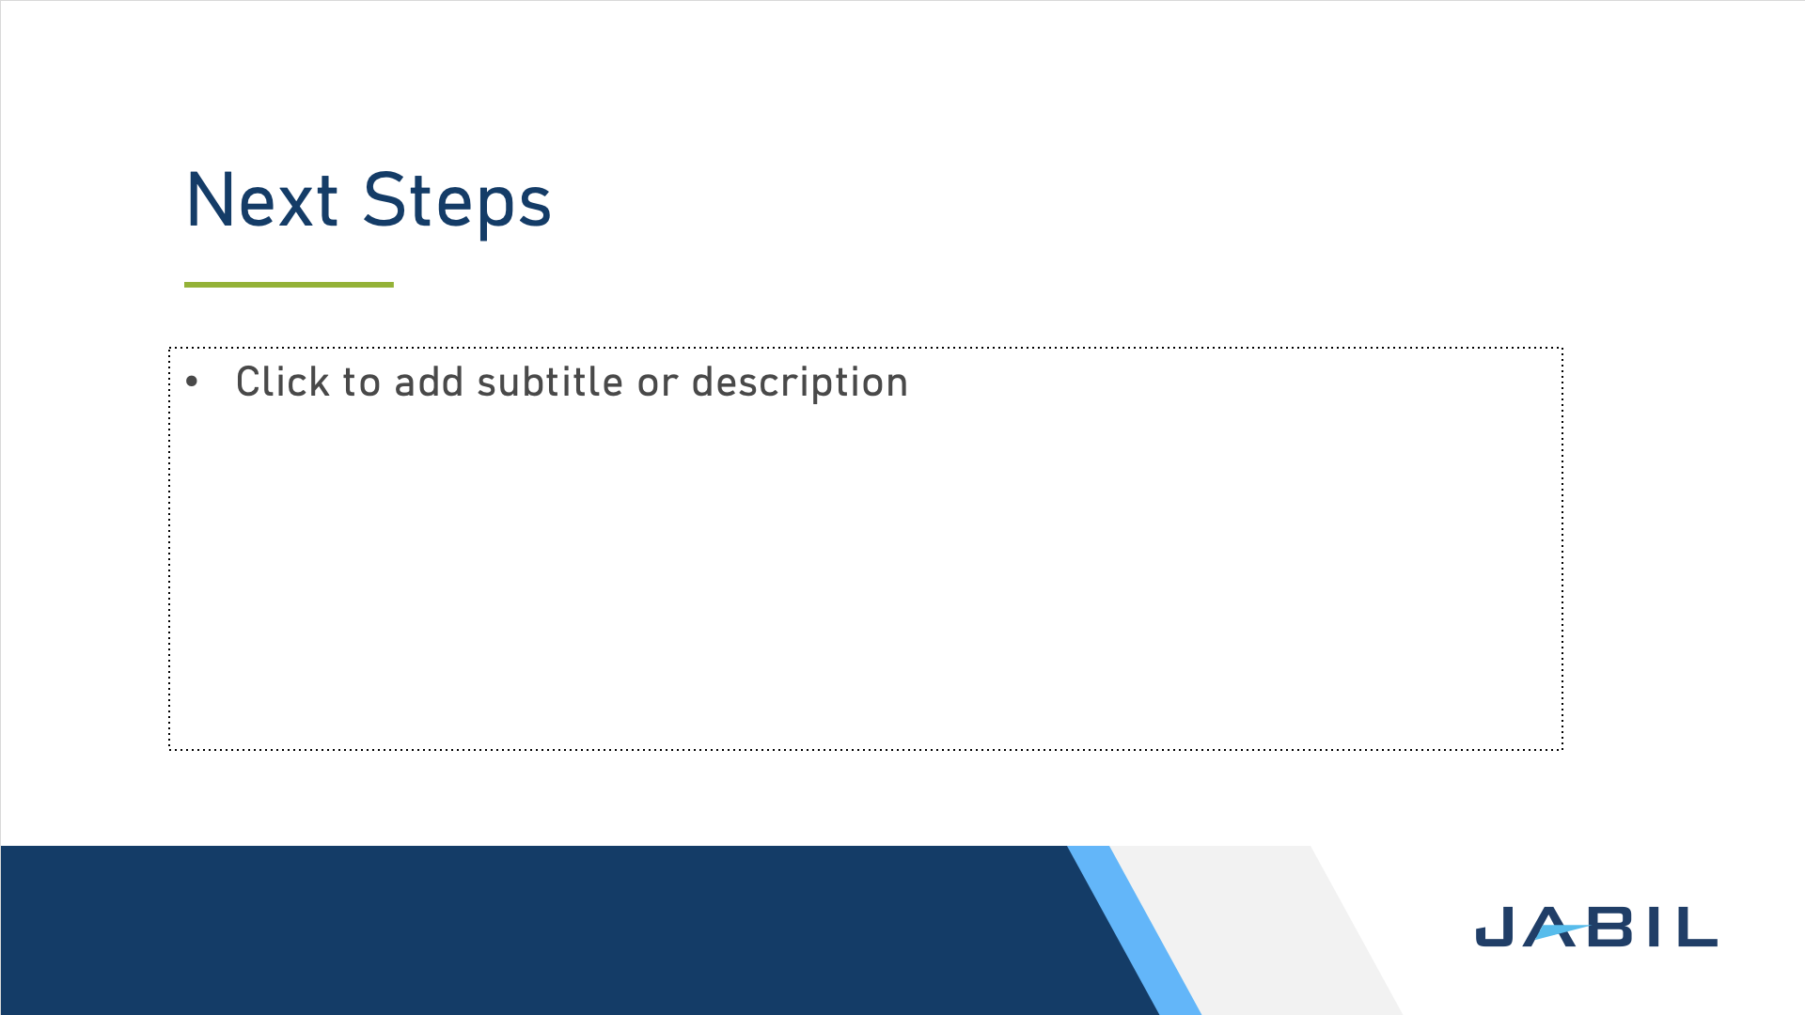
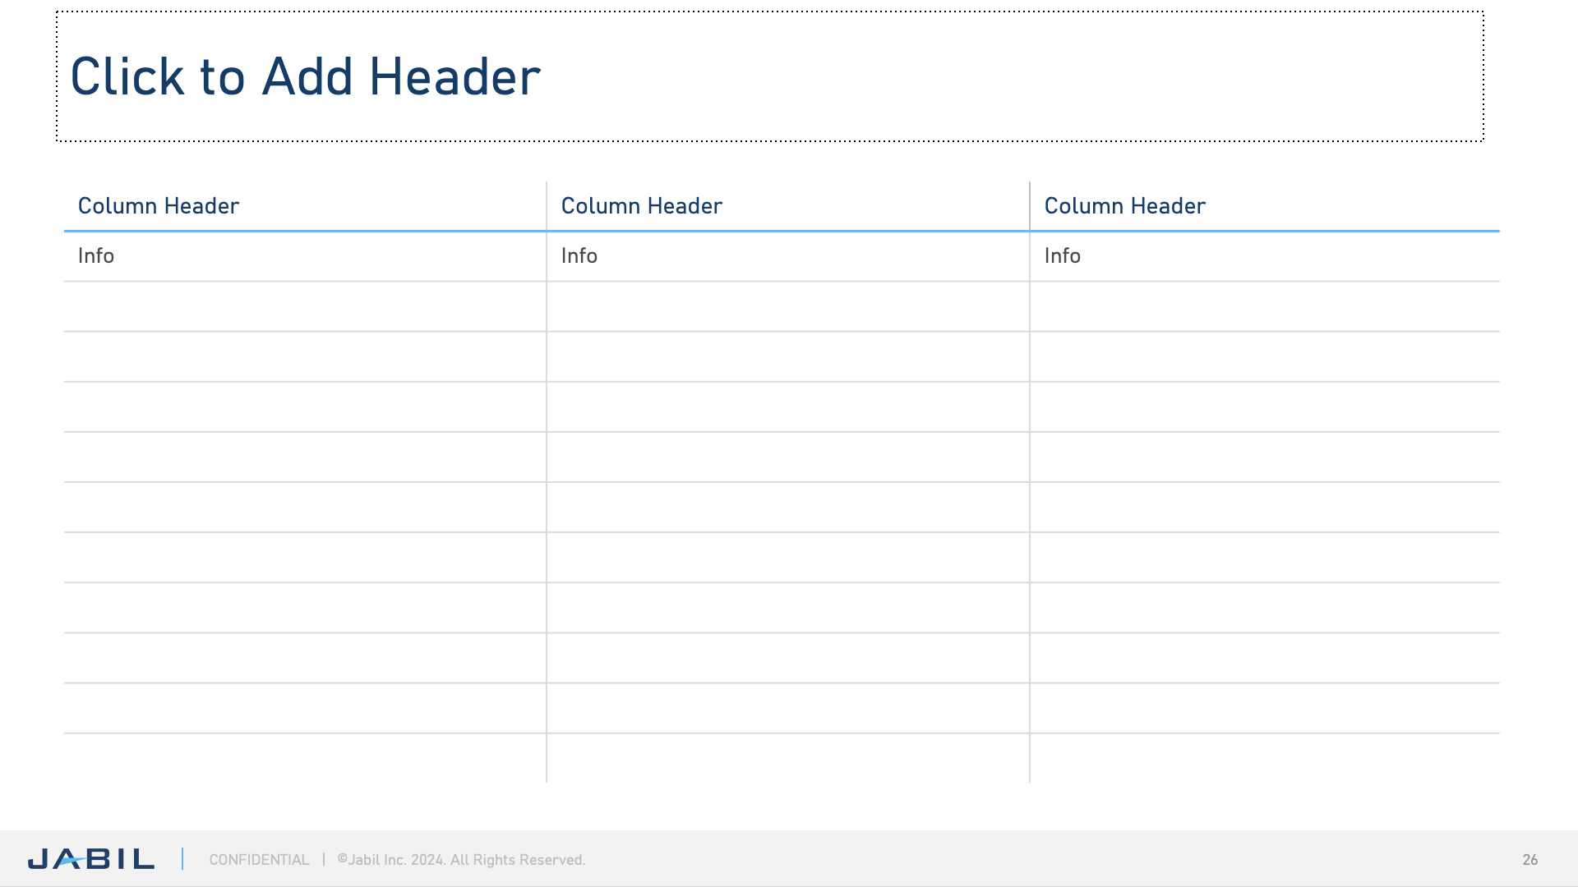
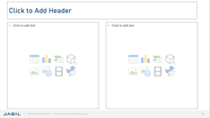

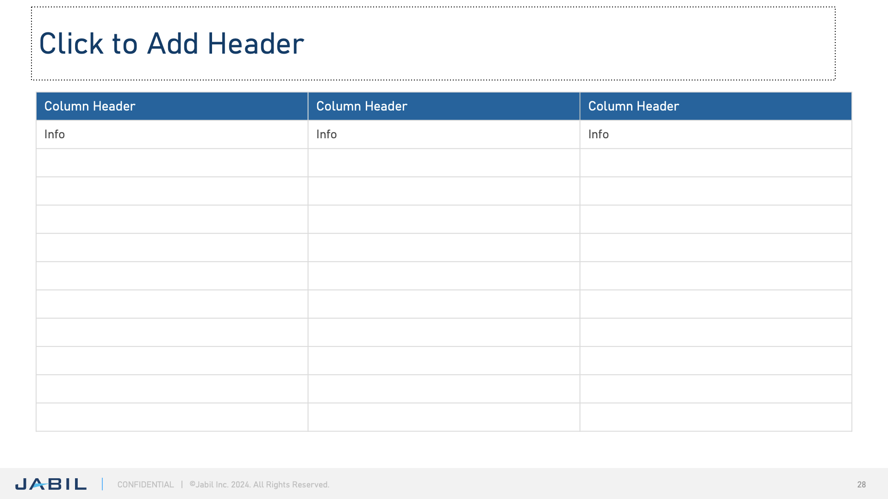
Content Slides
More layouts are available in the Slide Layout Library.
In addition to covers and section headers, the following content and closing slides are built into this template:
Header
Blank
Closing Logo/Tagline Animation
Header
Text
Agenda
Thank You
Header
Subhead
Text
Next Steps
Tables
Header
2 Textboxes
Q&A

Slide 11
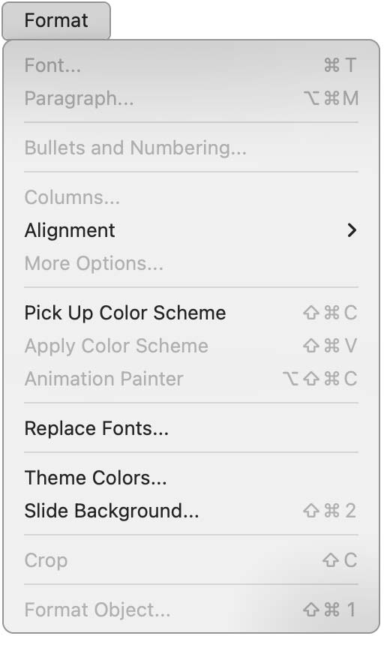
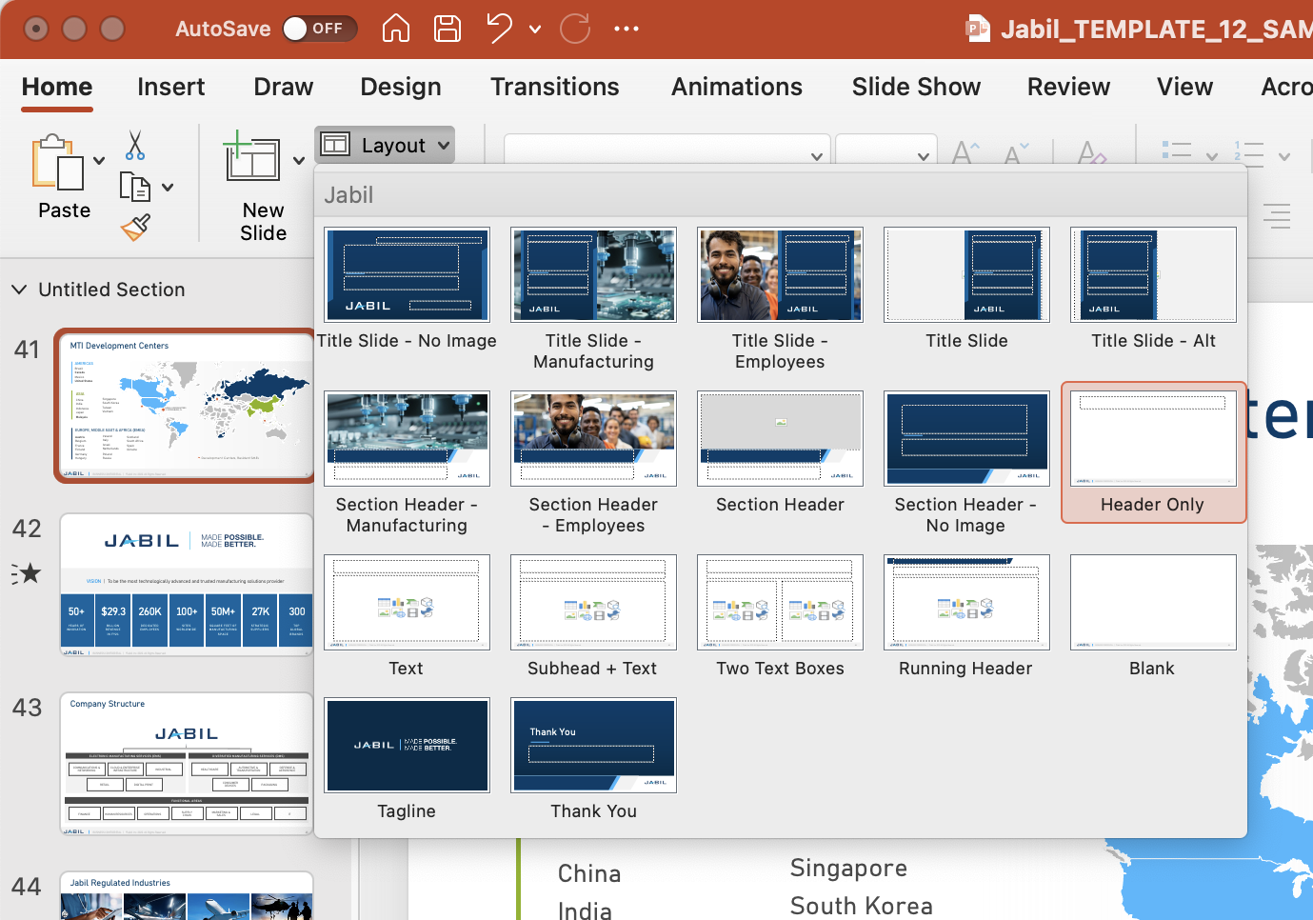
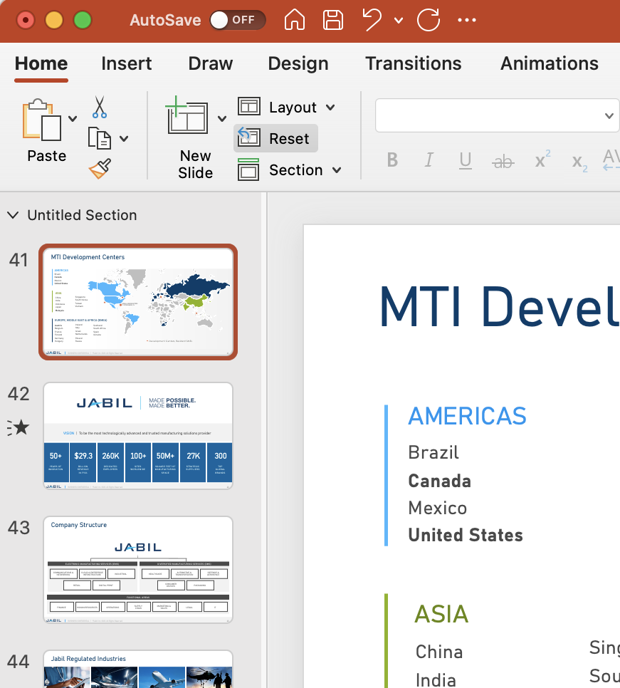
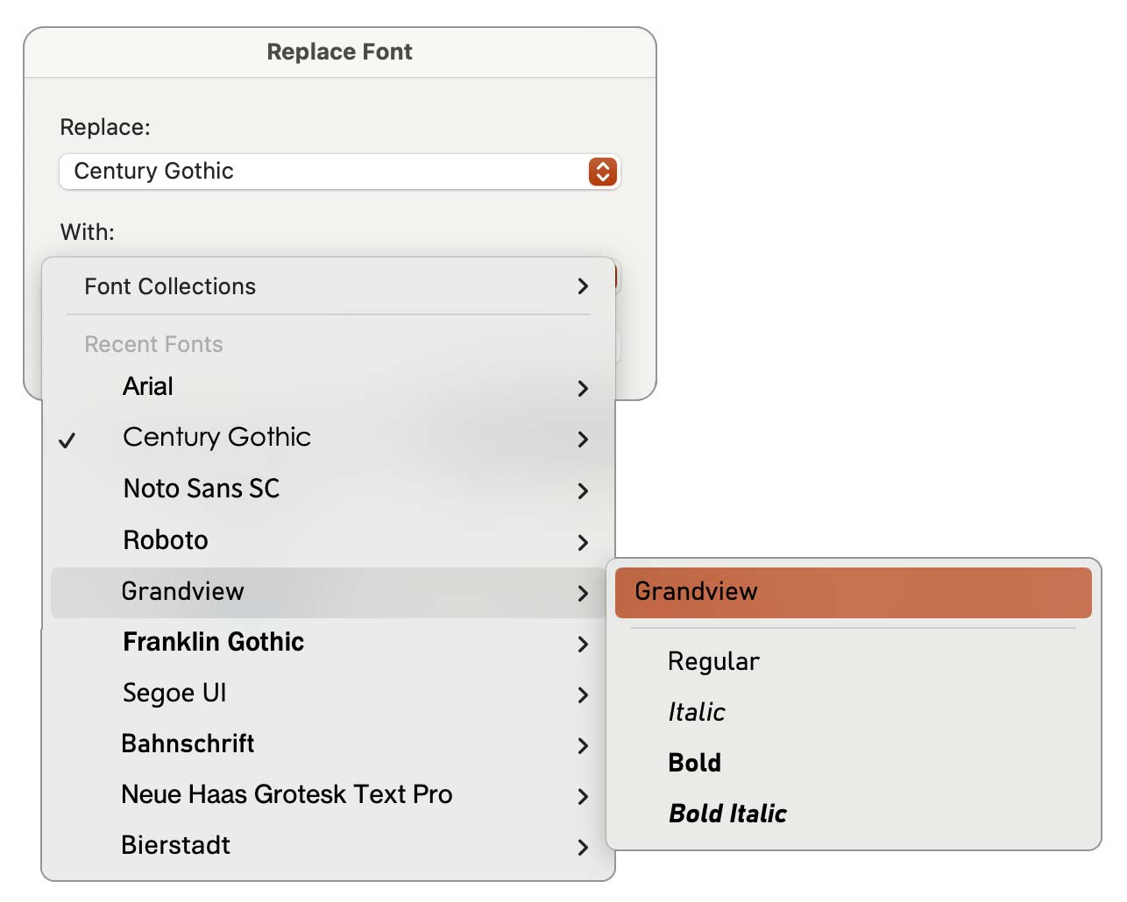

Transferring Slides into this Template
1
Copy slides from your previous decks and paste into this template. Then, select the appropriate Layouts for your slides.
2
Click Reset to adjust slide formatting to default settings.
3
From the menu bar at the top of your screen, choose Format and Replace Fonts.
Select each font in the Replace menu.
Choose Grandview.
Pasting in slides from old decks will add additional (old) layouts. Please avoid using outdated layouts.
Click Replace.

Slide 12
Data Classification
Data Classification
Click here for more information.
Before you begin your deck, determine the classification of your information.
Public
Information that is generally not sensitive outside of Jabil. Its unauthorized disclosure, destruction, or loss of integrity would have little or no impact on Jabil or Jabil’s constituents.
Examples:
Information available on Jabil.com:
Site information
Capabilities
Case studies
Financial information
Approved press releases
If your information may be shared freely outside of Jabil, open the Slide Masters and change the footer to read:
Confidential
Information that is sensitive within the company and is intended for business use only by specific groups of employees. This is non-public information from the Jabil’s business operations that is proprietary, private, trade secret, sensitive, or subject to contractual or other legal obligations of confidentiality and that must only be made available to partners or individuals with a business need and right to know.
Examples:
Customer-specific content
Site/capability information
Case studies
Company Org charts
Internal and Customer Audit Reports
By default, this template is Confidential.
Restricted
Information that is extremely sensitive, of highest value to the company and intended for use by named individual(s) only. Its unauthorized disclosure, destruction, or compromise would result in substantial loss or damage to Jabil, or a Jabil constituent’s, integrity and reputation, significant financial liability, significant advantage to a competitor, financial penalties, and legal requirements.
Examples:
Executive Strategic plans
Pricing data
M&A Activity
Customer Information
If your content is extremely sensitive, open the Slide Masters and change the footer to read:
Regulated
Information that is covered by, and relevant to, an external regulatory or customer requirement.
Examples:
PII
PHI
PCI
ITAR
FDA
SOX
Customer IP determined by customer contract
If your content is considered regulated, open the Slide Masters and change the footer to read:
REGULATED | ©Jabil Inc. 2023. All Rights Reserved.
RESTRICTED | ©Jabil Inc. 2023. All Rights Reserved.
PUBLIC | ©Jabil Inc. 2023. All Rights Reserved.

Slide 13
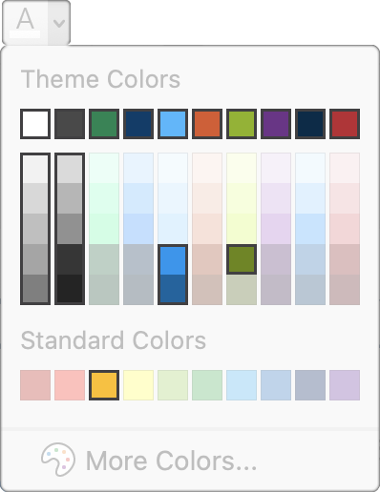
The Jabil Color Palette
PRIMARY COLORS
The highlighted colors
below are approved for use.
When a bright blue or green is needed for critical text or graphic elements:
Use these colors on darker backgrounds
Use these colors on white backgrounds
SECONDARY COLORS
ADDITIONAL COLORS TO BE USED JUDICIOUSLY
Avoid using pastel shades.
Use in charts and graphs where distinct colors are needed.

Slide 14
Font & Special Characters
The Jabil font for all presentations is Grandview.
Use STXihei for Chinese. Use MS Gothic for Japanese. All three of these fonts are built into Microsoft 365/PowerPoint.
Instructions on the following slide show you how to easily update all the fonts throughout your presentation.
SPECIAL CHARACTERS
À È Ì Ò Ù à è ì ò ù
Á É Í Ó Ú Ý á é í ó ú ý
Â Ê Î Ô Û â ê î ô û
Ã Ñ Õ ã ñ õ
Ä Ë Ï Ö Ü Ÿ ä ë ï ö ü ÿ
Ő ő Ű ű
Å å Ž š Ç ç § ß
Ð ð Þ þ ƒ Æ æ Œ œ
© ® ™
€ £ ¢ ¥
¿ ¡
= ≠ ≈ ± × ÷ > < ≤ ≥ ¼ ½ ¾ ‰
° ∞ Ω ◊ ∂ ∏ ∑ π µ ¬ Ø ø º ¹ ª
¶ ‡ † … „ ˛ ¸ ˘ ˇ ^ « ‹ › »
En dash –
En dashes are used to show ranges of any kind. This could be in numbers, such as page numbers (55–102) or time (1:00–2:30), or months, such as July–October.
Em dash —
Em dashes can be used in place of commas, colons, semi-colons, or parentheses. They are mainly used to set a phrase apart.

Slide 16
Notes:
Cover Library:
https://jabil.sharepoint.com/:f:/s/MarketingResourceCenter/EtdHO0fWUcJAqJpV4WTEiYQB-yrTp8C1MIL5vOz57HSpYg?e=gNsbD6

Slide 17
Notes:
Cover Library:
https://jabil.sharepoint.com/:f:/s/MarketingResourceCenter/EtdHO0fWUcJAqJpV4WTEiYQB-yrTp8C1MIL5vOz57HSpYg?e=gNsbD6

Slide 18
Notes:
Cover Library:
https://jabil.sharepoint.com/:f:/s/MarketingResourceCenter/EtdHO0fWUcJAqJpV4WTEiYQB-yrTp8C1MIL5vOz57HSpYg?e=gNsbD6

Slide 19
Notes:
Cover Library:
https://jabil.sharepoint.com/:f:/s/MarketingResourceCenter/EtdHO0fWUcJAqJpV4WTEiYQB-yrTp8C1MIL5vOz57HSpYg?e=gNsbD6

Slide 20
Notes:
Section Header Library:
https://jabil.sharepoint.com/:f:/s/MarketingResourceCenter/EgI-Oyqz8bpGp6b6BgjTOQ8BdZrQCFyDZHiW-yNcg3-1Vg?e=HRLzIw

Slide 21
Notes:
Section Header Library:
https://jabil.sharepoint.com/:f:/s/MarketingResourceCenter/EgI-Oyqz8bpGp6b6BgjTOQ8BdZrQCFyDZHiW-yNcg3-1Vg?e=HRLzIw

Slide 22
Notes:
Section Header Library:
https://jabil.sharepoint.com/:f:/s/MarketingResourceCenter/EgI-Oyqz8bpGp6b6BgjTOQ8BdZrQCFyDZHiW-yNcg3-1Vg?e=HRLzIw

Slide 24
Agenda
0:00 – 0:00 Agenda Item
0:00 – 0:00 Agenda Item
0:00 – 0:00 Agenda Item
0:00 – 0:00 Agenda Item
0:00 – 0:00 Agenda Item
0:00 – 0:00 Agenda Item
0:00 – 0:00 Agenda Item
Notes:
Need an image?
https://jabil.sharepoint.com/sites/MarketingResourceCenter/SitePages/Images.aspx

Slide 29
Column Header | Column Header | Column Header | Column Header | Column Header
Info | Info | Info | Info | Info

Slide 30
Column Header | Column Header | Column Header
Info | Info | Info

Slide 31
Column Header | Column Header | Column Header
Info | Info | Info

